Slide 1
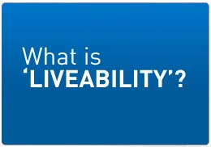
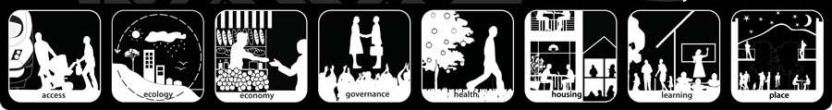
Lesson 2

Slide 2

'Liveability' - the qualities of a place (city, town, suburb, neighbourhood) that contribute to the quality of life experienced by residents and others.

Slide 3
‘Liveability’ – Cities
Location
Resources
Communications
Services
Urban? Rural, remote?
Water, electricity, gas, sanitation
Road, phone, internet, public transport, shipping
Economy
Government
Performance, policy – environment, crime rates, tax etc
Stable, flourishing? – trade, GDP, Job opportunities, affordable housing
Health, education, housing, entertainment, cleanliness, safety - police
Geography
Climate, terrain, location

Slide 4

Most & Least ‘Liveable’ Cities
http://www.telegraph.co.uk/travel/10270269/The-worlds-most-liveable-cities-2013.html?frame=2654758
http://www.telegraph.co.uk/travel/travelnews/10270633/The-worlds-least-liveable-cities-2013.html

Slide 6
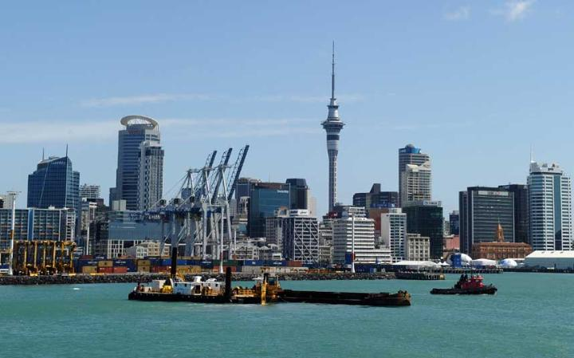
10

Slide 7
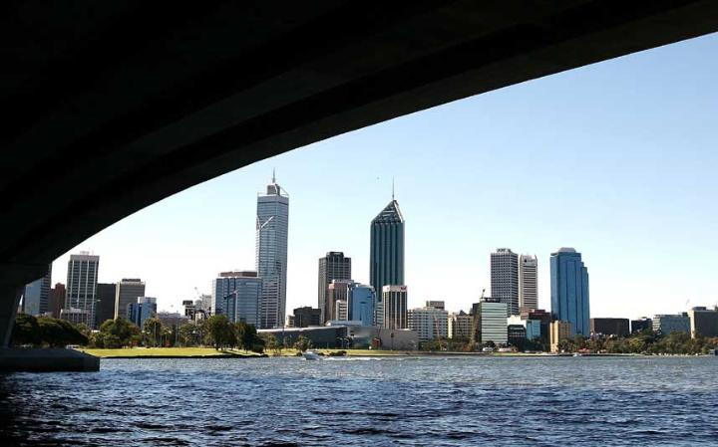
9
"The city on the Swan is beginning to lose its teenage awkwardness. A booming local economy is attracting talent and investment from around the world. And the city's much-touted "Mediterranean lifestyle" based around sailing, dining and the beach now seems incredibly attractive. "

Slide 8
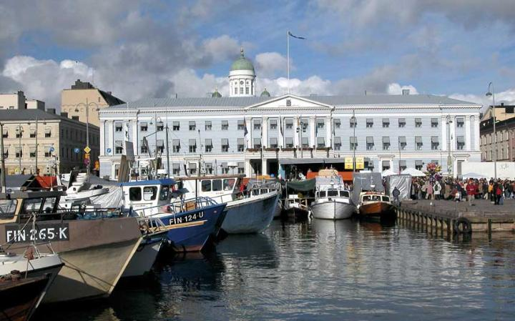
8
"Helsinki is a city on the crest of a newfound confidence, enjoying the afterglow of its reign as last year's World Design Capital and proud centre of one of Europe's most prosperous countries"

Slide 9
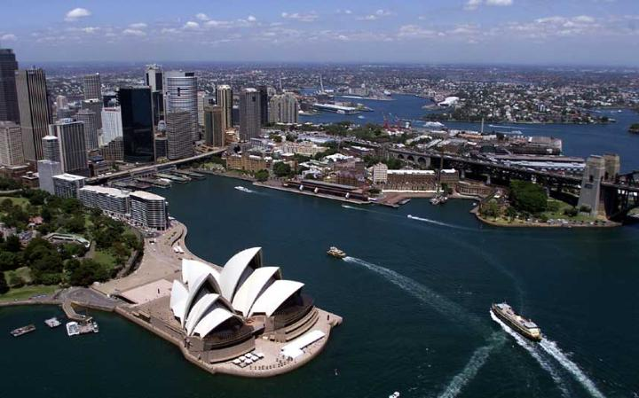
7
Apart from its made-for-television harbour, this city has just about everything a visitor might desire: great surf beaches, world-class cuisine, a flamboyant nightlife, high-end shopping, art galleries, museums, grand Victorian parks - not to mention the Sydney Opera House, one of the greatest buildings of the 20th century."

Slide 10
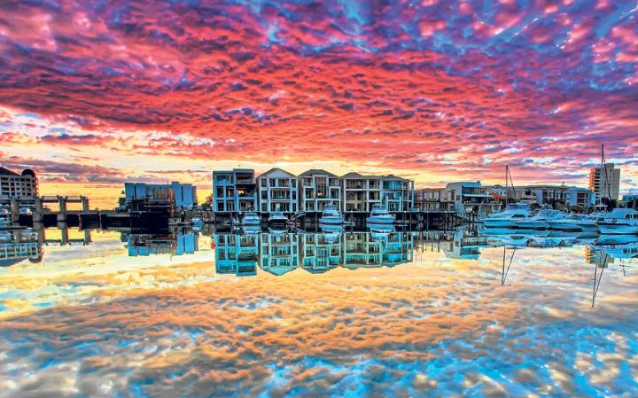
6
Adelaide, surely the most elegant of all Australian cities with its tree-lined boulevards and glorious Victorian parklands, conjures up two powerful (and conflicting) images in the minds of non-South Australians: the revered batsman Sir Don Bradman, who is buried here, and Don Dunstan, a flamboyant state premier who outraged 1960s Australia by wearing pink shorts into parliament.

Slide 11
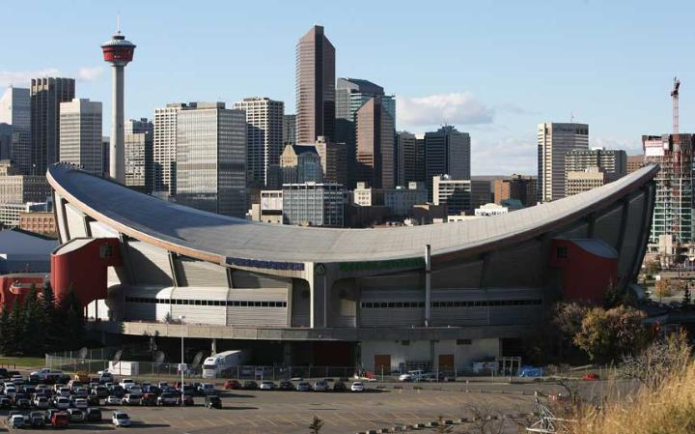
5
"Calgary is a city possessed. Not repossessed in any boring bailiff way, but taken over, body and soul, in the all-powerful, almost supernatural sense. By spirits, you ask? Yes, siree! By the spirits of the Old West. In Calgary, in the Canadian province of Alberta, it's Stampede time

Slide 12
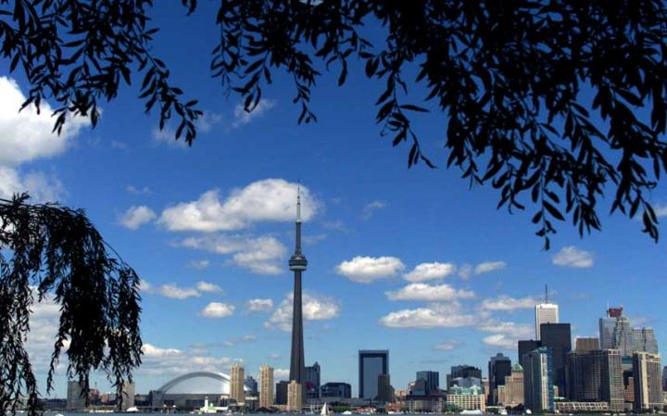
4
North America's fourth largest city is arguably its most vibrant, thanks to the waves of young immigrants, who have transformed a rather sober destination into the world's most cosmopolitan. Few cities are as creative, thanks to talented fashion designers and artists, architects and craftspeople, musicians and chefs. The museums are world class, while the large student population adds to the buzz.

Slide 13
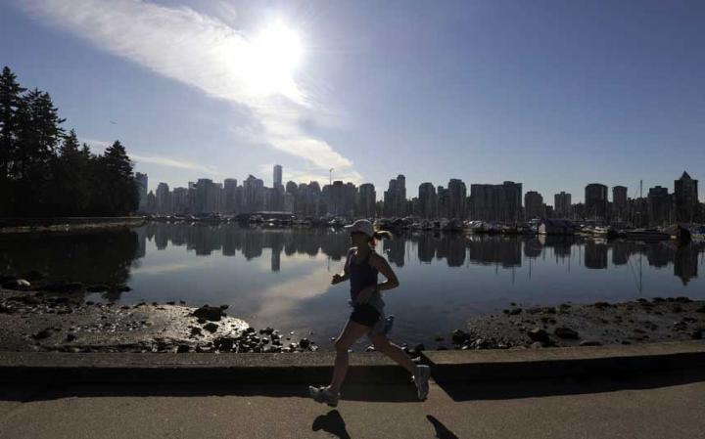
3
When prizes are handed out for the "best place to live in the world", Vancouver regularly gets a mention. What felt like a big town on my first visit a decade ago is now a grown-up city, with glass tower blocks, a buzzy cultural life and a cosmopolitan population that includes newcomers from Asia, as well as home-grown Canadians and first-generation Europeans. And nowhere is this ethnic mix more representative than on a plate in one of Vancouver's atmospheric restaurants.

Slide 14
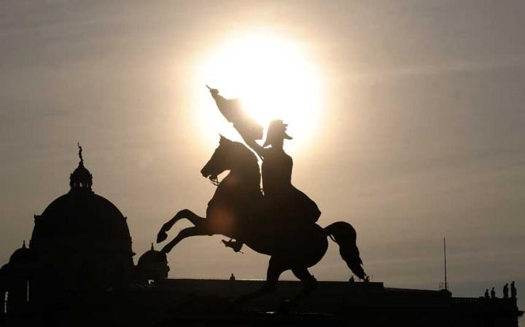
2
There is much more for lovers of Art Nouveau, too, to enjoy in this city right now, from the glorious gold-leafed structure that bears the name of the Secessionists to the brave new buildings, artworks and artefacts that they fashioned so beautifully. Then, of course, there are all the other reasons to visit Vienna, especially as it slips into its cosy, Christmassy winter coat: from the imperial splendour of the Habsburg heritage and the sublime music of Mozart, Strauss and Beethoven, to the charm and old-world character of its coffee houses and the tastiness of its strudels, schnitzels and Sachertorte

Slide 15
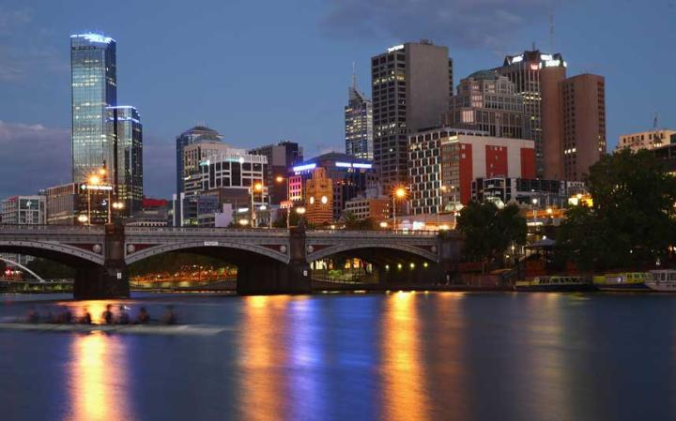
1
Birthplace of Australian Rules Football, host of the 1956 Olympic Games, home of both the Australian Open and the Australian Grand Prix, Melbourne can rightly claim to be the sportiest city in a country where sport is the only true religion. "Stuffy? Old-fashioned? Nonsense. Caffeine-fuelled, sports-mad and outward looking, Melbourne is unquestionably Australia's most exciting and diverse metropolis.

Slide 16
Most Liveable Cities in the World | Least Liveable Cities in the World
1. Melbourne, Australia | 1. Damascus, Syria
2. Vienna, Austria | 2. Dhaka, Bangladesh
3. Vancouver, Canada | 3. Port Morseby, Papua New Guinea
4. Toronto, Canada | 4. Lagos, Nigeria
5. Calgary, Canada | 5. Harare, Zimbabwe
6. Adelaide, Australia | 6. Algiers, Algeria
7. Sydney, Australia | 7. Karachi, Pakistan
8. Helsinki, Finland | 8. Tripoli, Libya
9. Perth, Australia | 9. Douala, Cameroon
10. Auckland, New Zealand | 10. Tehran, Iran

Slide 17
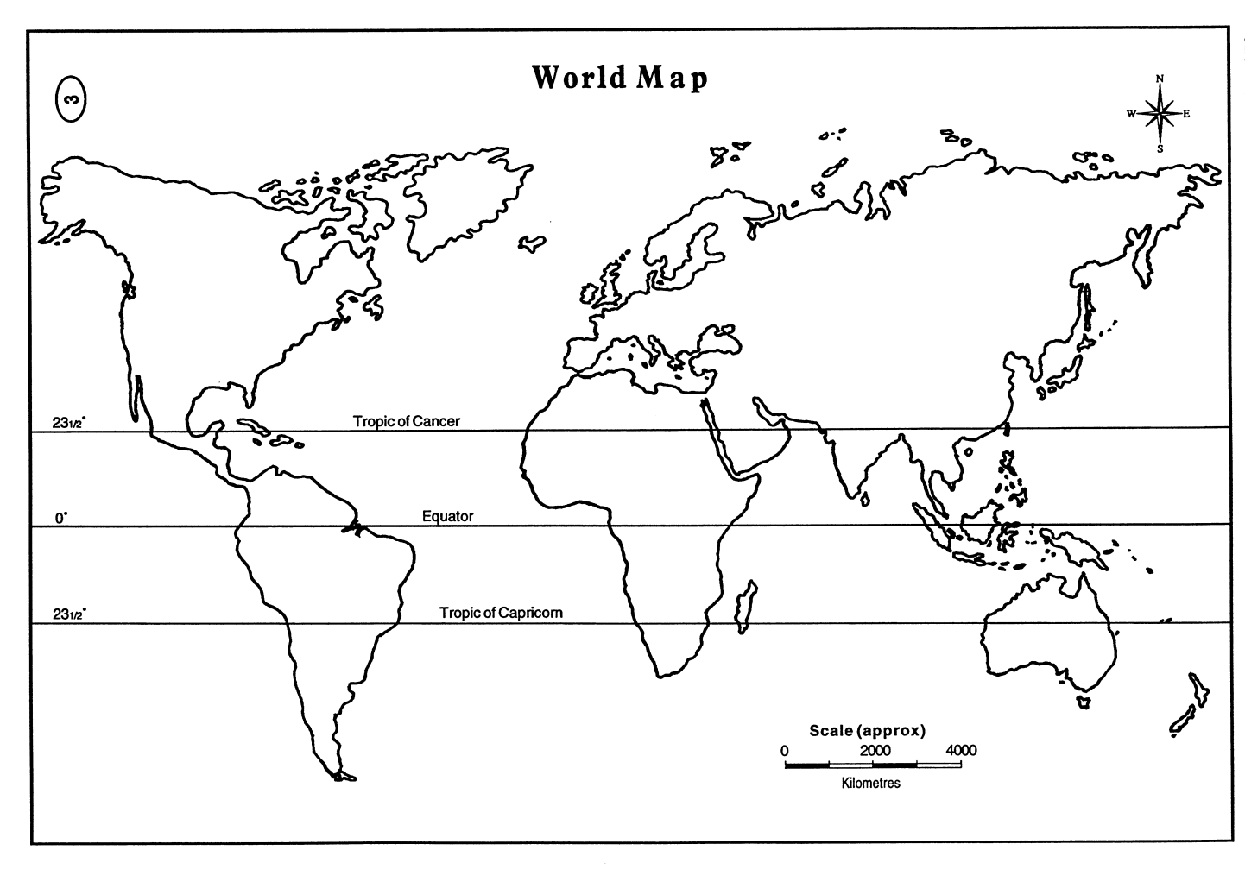
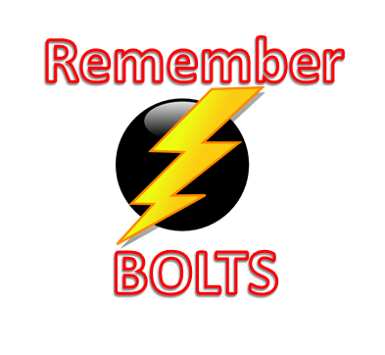
Mapping the
Most & Least ‘Liveable’ Cities

Slide 18

Most and Least Livable Cities
8
3
5
4
2
6
1
10
8
Bangladesh
7
2
4
9
3
5
Legend
7
9
6
Melbourne
1
10
Liveable
Unliveable

